Slide 1
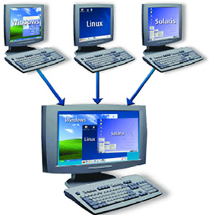
LINUX – USER ACCOUNT MANAGEMENT
Docente: Dott. Daniele Gobbo Modulo 3

Slide 2
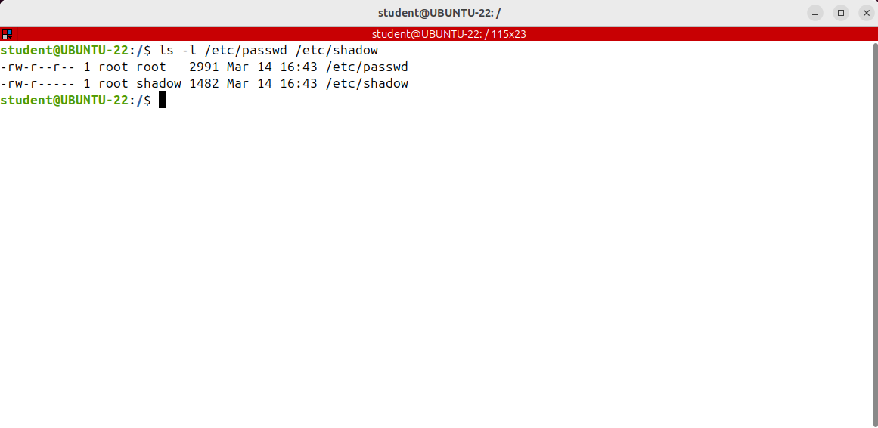
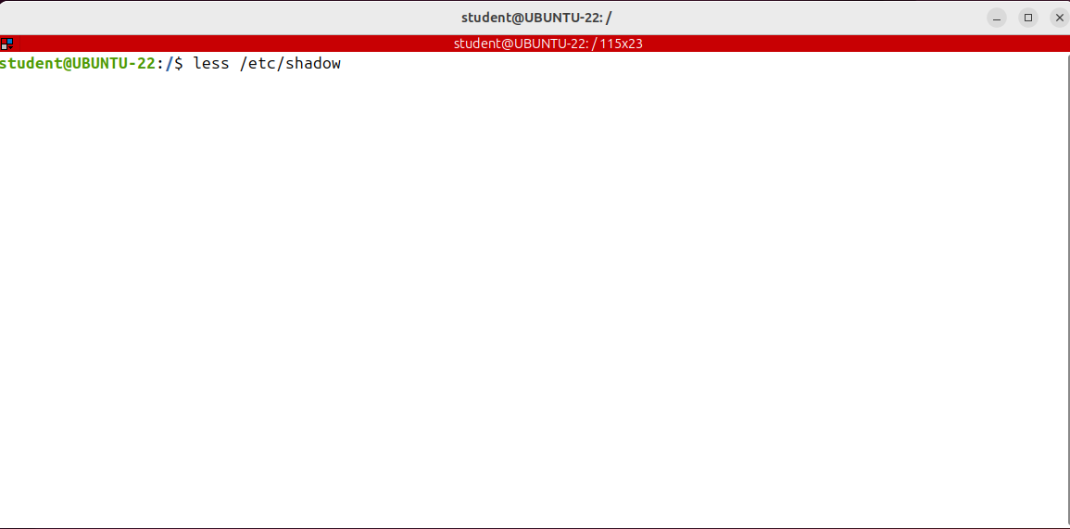
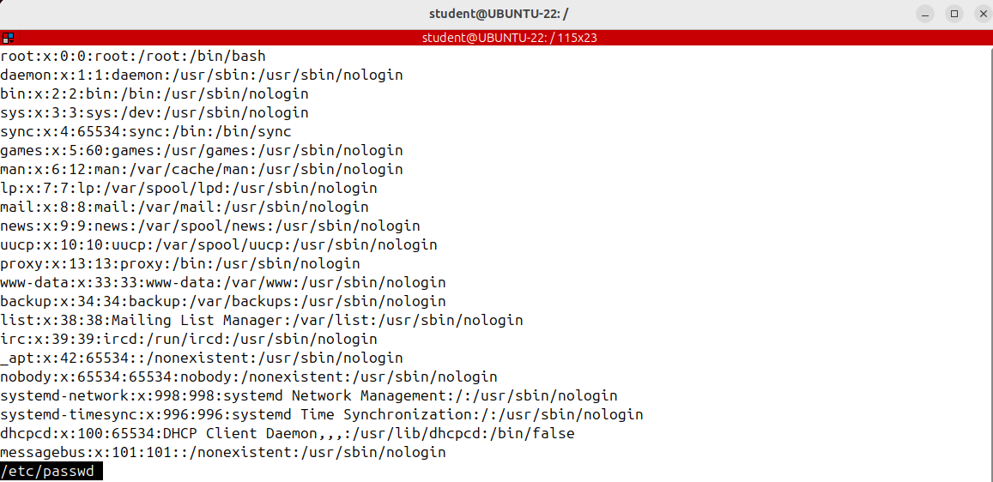
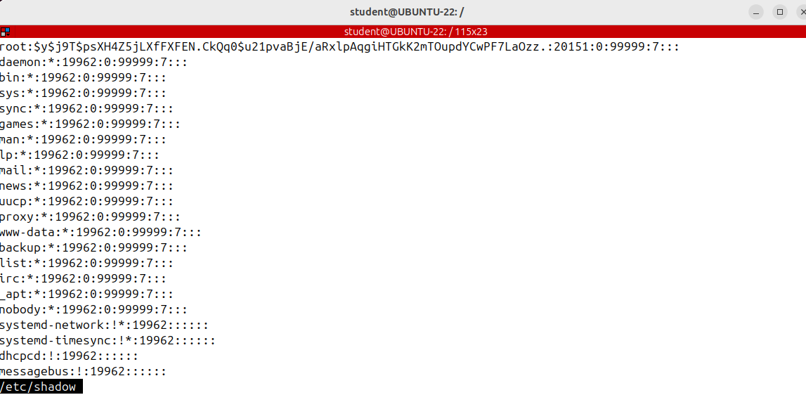


Understanding passwd and shadow files
We what to know how the Linux system performs authentication.
There are two files of particular interest to us:
/etc/passwd and /etc/shadow.
The /etc/passwd file contains basic information about each user account on the system.
The /etc/shadow file stores the actual passwords of the users in an encrypted format.
It stores the actual passwords of the users in an encrypted format.
In fact, there is the hash of the password with additional properties related to users' passwords like password expiration dates.
The /etc/passwd file is world-readable and that means that any user can read it but the shadow file, this file, is only readable by the root account.
At the beginning of the Unix era, used to contain an encrypted password
If this second field is blank, the user does not need to enter a password to log in.
The third field is the user ID, a positive integer number assigned to the user, followed by the group
ID in the fourth field.
Username:this is how a line in the shadow file is connected to the corresponding line in the password file.
The second field represents the password, the entire string between these two colums.
7 fields related to password expiration date like last password change, minimum and maximum password age and so on.
if the password field contains an asterisk or an exclamation point the user will not be able to login to the system using the password authentication.
is the user's home directory.
The fifth field is a comment.
User login name
is the default shell usually set to /bin/bash.
If instead of bash you see there nologin of false it means there is a system user that’s
not allowed to log into the system.
Please exiting the file by pressing on q.

Slide 3
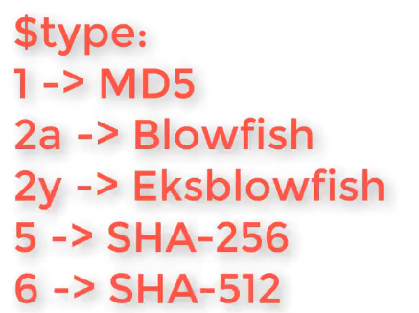
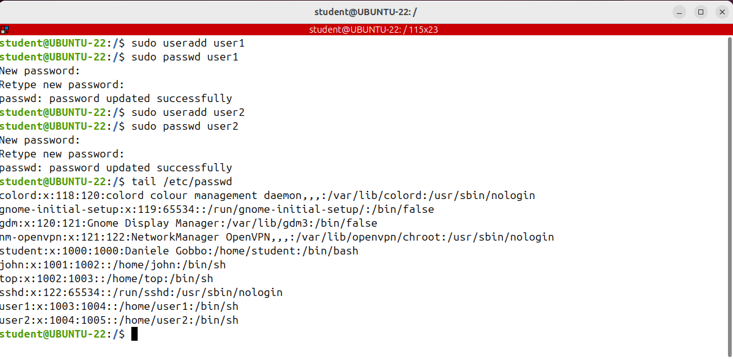
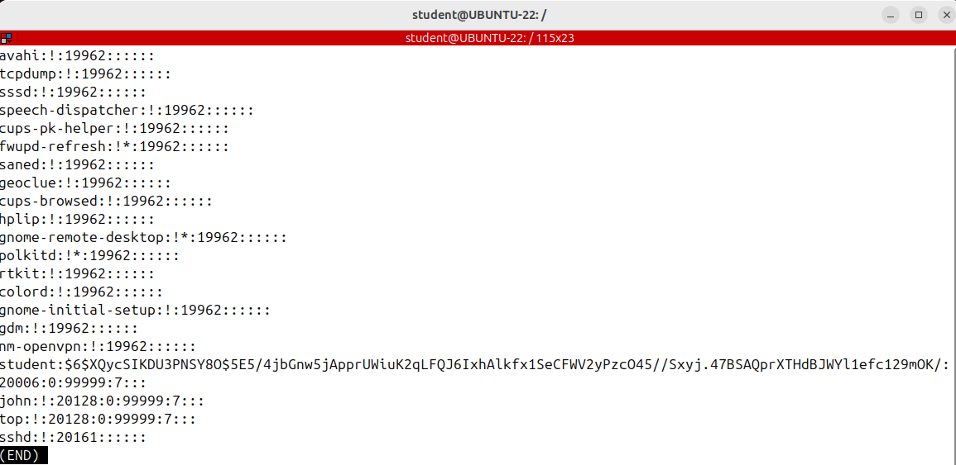
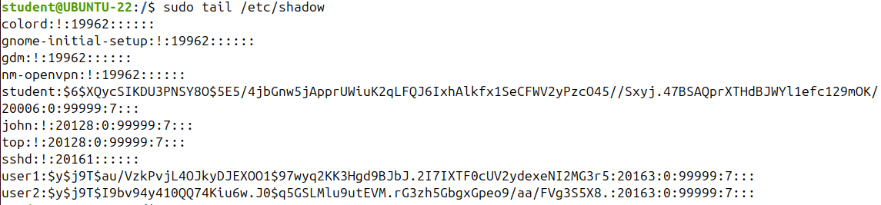
Understanding passwd and shadow files
This selected field.
Usually the password format is set to $type, in this case $6, $salt and $hashed.
A salt combined with the pastword
is added to the hashing process to enforce the uniqueness of the outhash or in other words,
the same password will give different hashes because of this random alt. This mitigate password attacks
like rainbow tables,
the salt is randomly generated for each password, but it’s not secret like the password is. If through having the hash an attacker can find the clear text password, all the other similar passwords of other users are still secure because their hash is different.

Slide 4
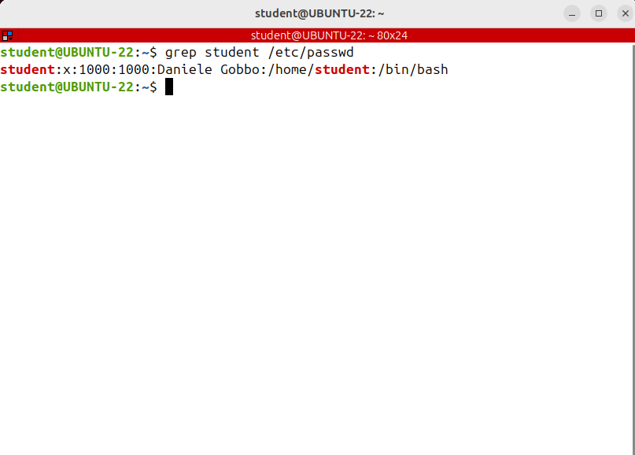
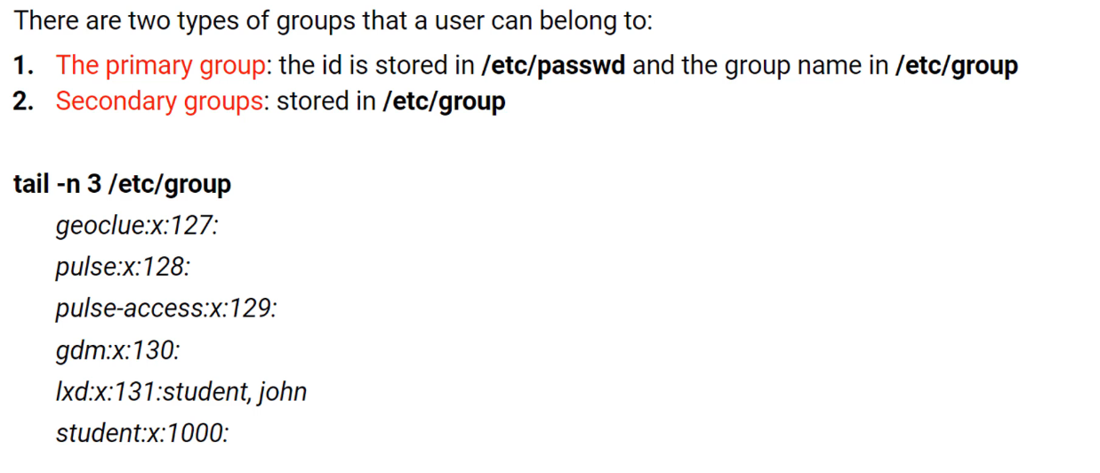
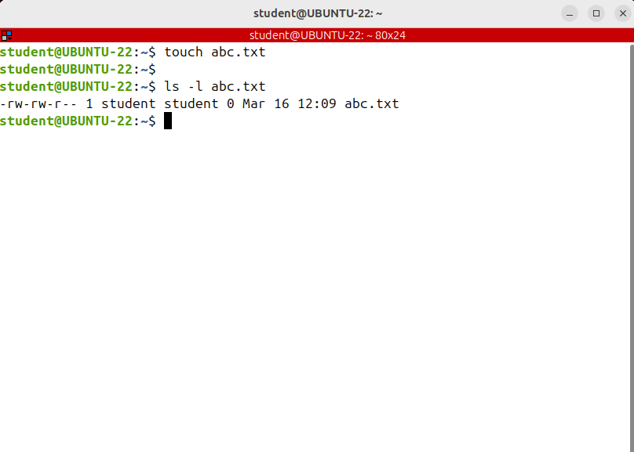
Understanding Linux Groups (groups, id)
The user that runs t touch command is the owner and its primary group( having usually the same name as the user) is the group owner.
Note that each user must belong exactly to one primary group.
And there are secondary or supplementary groups. A user can be a member of none or more secondary groups.
The secondary groups are stored in /etc/group Let's see how to find out the groups where a user belongs to.
The main purpose of the groups is to define a set of privileges or permissions like read, write or execute for a given file that can be shared among the users within the group.
You have to add the user to a group if you want to have the privileges of the group.
Let's search the group file for that ID.
So the user's primary group is a group with the same name, student in this case; typically no other user will belong to this group.
Primary or login group is the group that is assigned to the files that are created by the user.
When a user creates a file, the user will be the owner of the file and its primary group will be the group owner of the file.
Remember that in Linux a file is owned by both a user and a group.
GROUP ID
USER ID

Slide 5
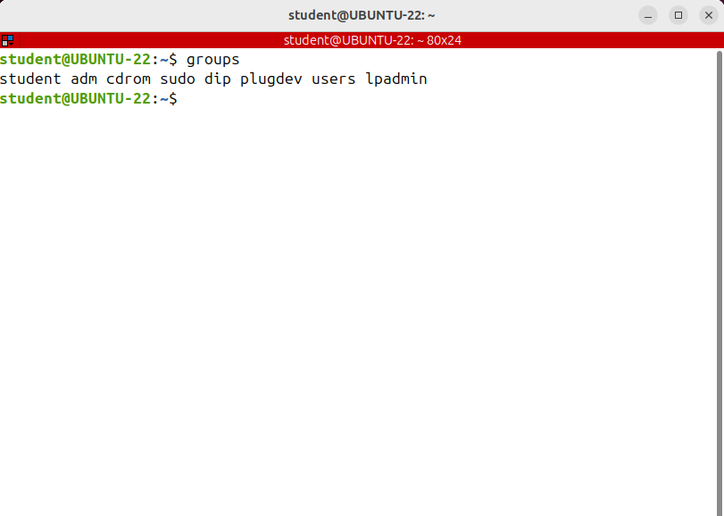
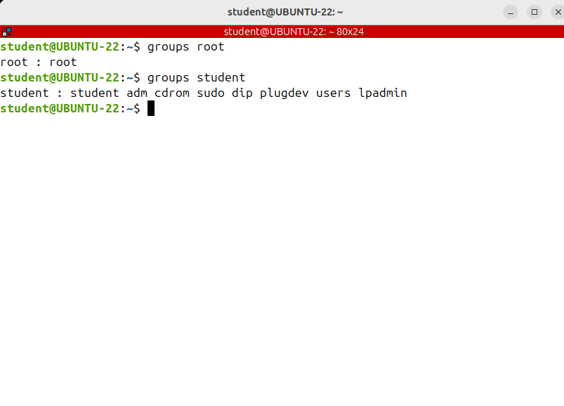
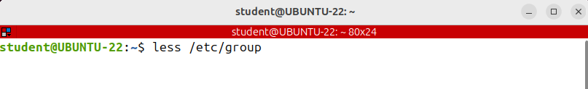
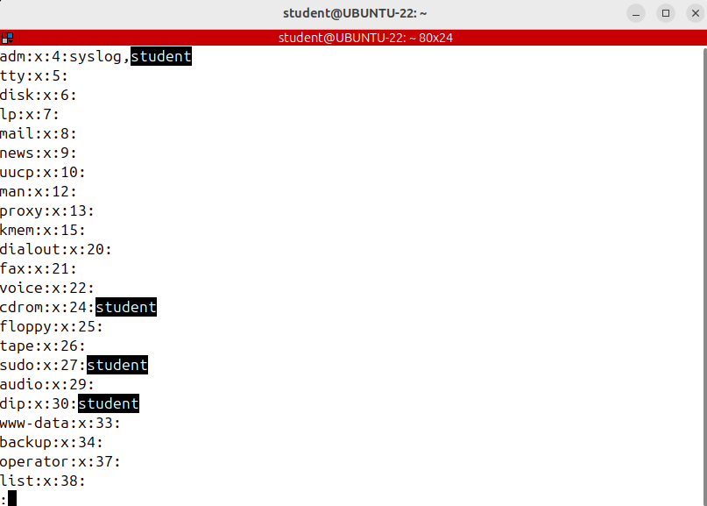

Understanding passwd and shadow files
Now let's find out the secondary groups of the user; to do that, I'll search for the user name in the group file.
When executed without any arguments, the command will print out a list of all groups the current user belongs to.
Another useful command is id. It prints information about the specified user and its groups and as the group command, if the username is omitted, it shows information for the current user.
The last field of each line indicates the users that belong to that group as a secondary group.
If there are more users belonging to the same group, which is quite common, then they are separated by a comma.
Normally, you don't search through these files to find out to which groups a user belongs. There's the groups command that does the job for you.
primary group

Slide 6
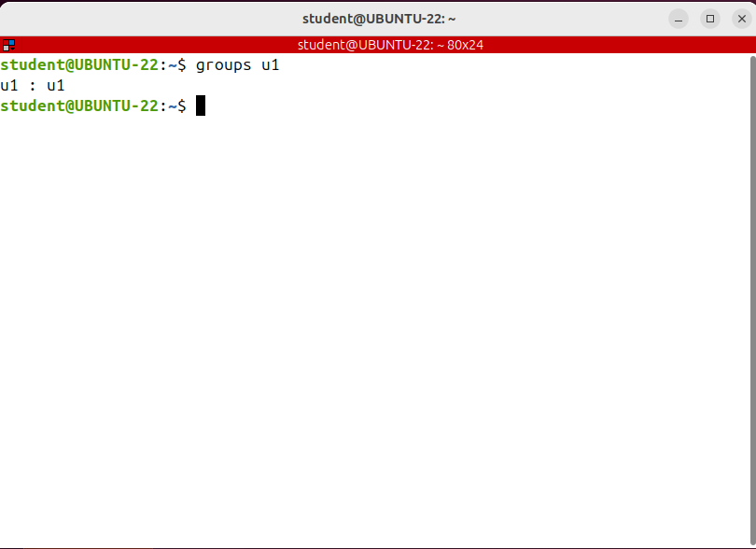
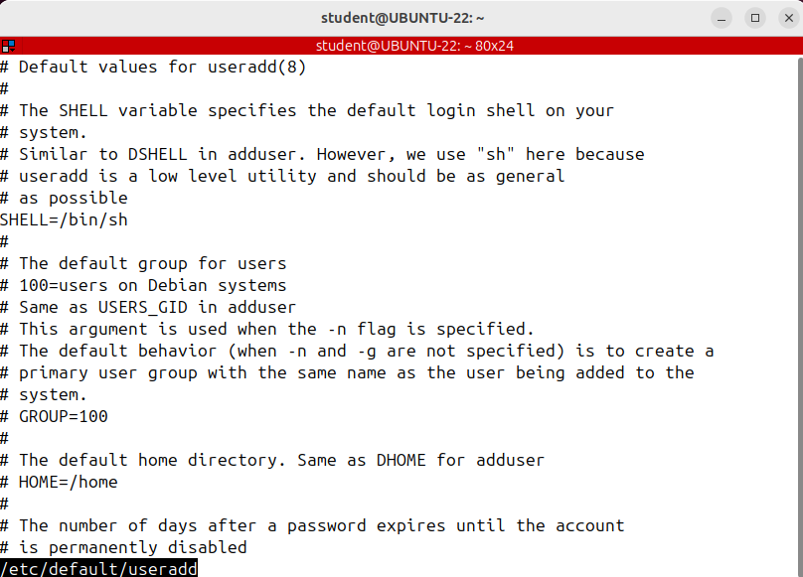
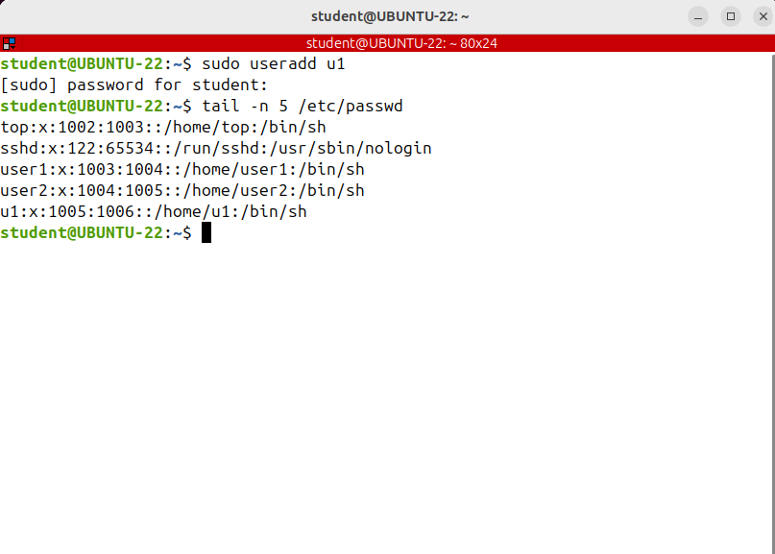


Creating User Accounts (useradd)
To be able to login is the newly created
User you need to set the user's password;
to do that passwd command followed by the username.
We need to know how to create new user accounts. In Linux you need root privileges to create, change or delete an account. To create a new account you run the useradd command.
Run man useradd and you’ll see lots of options.
To create a new user without specifying any options you run the useradd command
Now let's create the user by giving it the most common options manually.
If a user is created without any option, its home directory is not created as well.
There is no home directory for u1.
The user was created using the default options
from /etc/default/useradd
By default, for the new user a group with the same name as the user name was also created.

Slide 7
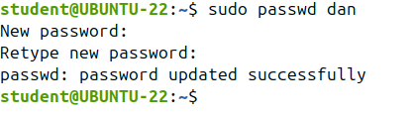
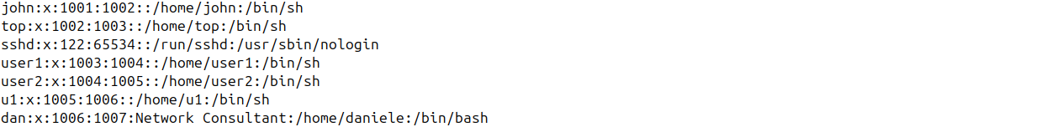
Creating User Accounts (useradd)
Now let's create the user by giving it the most common options manually.
If you want to create the user's home directory, use the -m option.
If you want to give it another name or create it in another location add the –d option.
If you want to add a comment to the user entry in /etc/ password file, add the -c option and a comemnt between quotes.
To create the user with a specific login shell at the -s option and the absolute path to that shell. That shell will be automatically launched when the user logs in or opens a terminal.
To add the user to some secondary groups as well. To do that, use the capital G option and the secondary groups with a comma between them let's say sudo,adm,mail Note that the groups should already exist or you'll get an error.

Slide 8
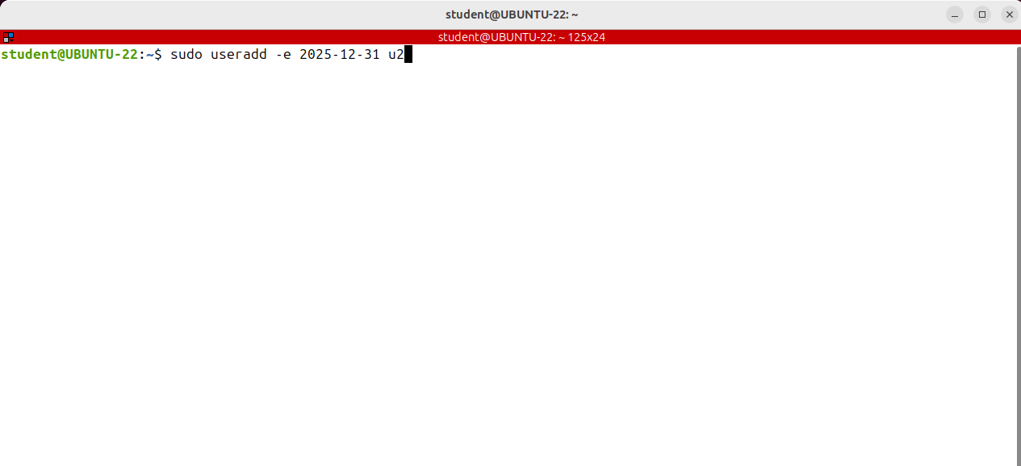
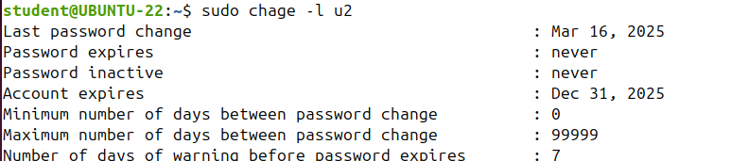
Creating User Accounts (useradd)
If you want to create a temporary user, then you should specify an expiration date, the date on which the user account will be disabled.
Use the -e option and the date in the format year, month, day.
If you want to change or list the user's password expire policy of an existing user run the chage command and the username.
So chage command and the username.
To show the aging information of an account add the -l option like this: -l james

Slide 9
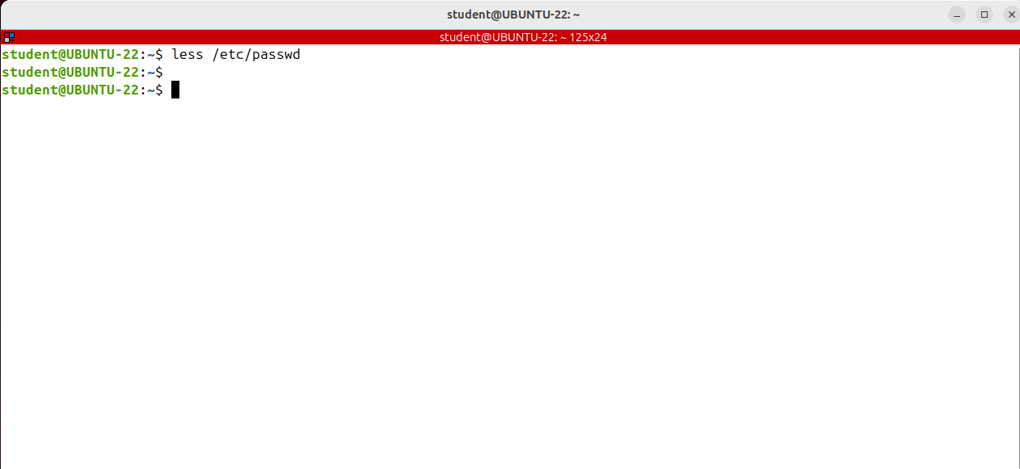
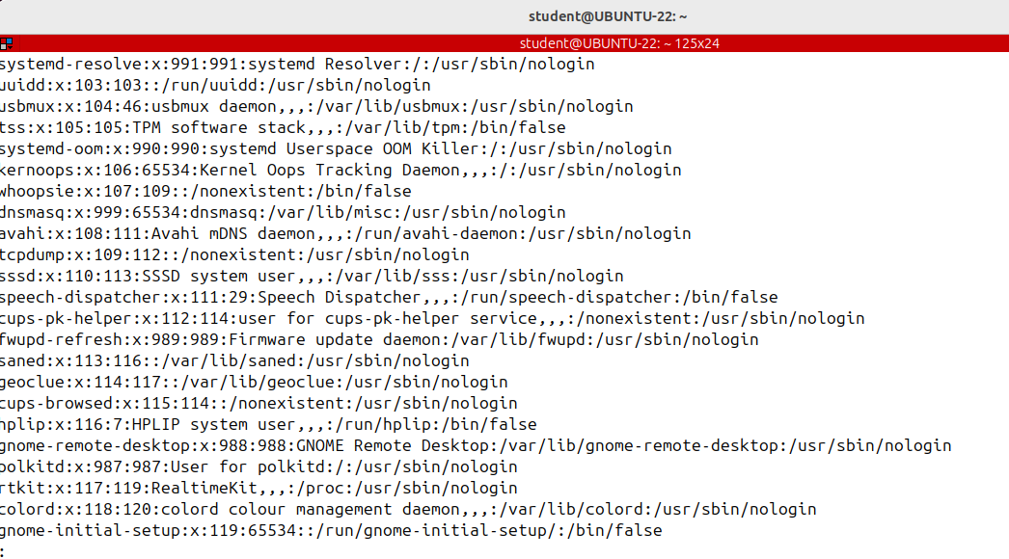
Creating User Accounts (useradd)
If you take a look in /etc/passwd you’ll see that some accounts have as shell something like /usr /bin/nologin or /bin/false
I'm sure it looks pretty strange, so I want to explain to you what it means.
Sometimes you need a system account to be used only to run a service such as a Web server.
In Linux every daemon or process should be run as a specific user and it’s recommended not to be root.
This is an important security consideration.
To have such a limited user account, that never logs in, you set its shell as being false or nologin.
If no login is set as the user's shell when the user tries to login, it will get a message saying this account is currently not available.
And false, is just a binary that immediately exists, returning false when called. That's why when someone that has false as shell logs in is immediately logged out.There isn't actually such a big difference
between no login and false.

Slide 10
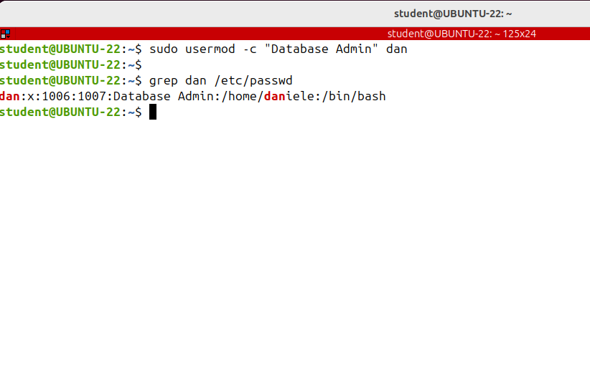

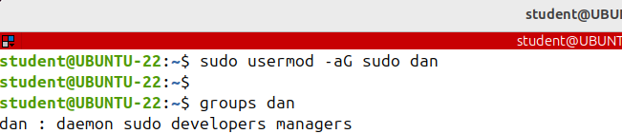
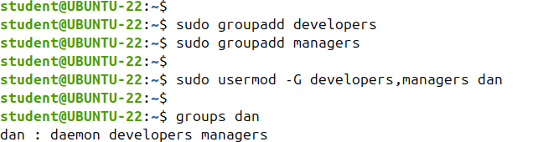
Changing and Removing User Accounts (usermod, userdel)
IMPORTANT:If the user is currently a member of a group, which is not specified as an option of -G, then the user will be removed from that group.
Or in other words, after running the command, the user will be a member of those groups only, in this case developers and managers groups.
The user is not anymore a member of adm, mail or sudo.
This behavior can be changed via -a option, which appends the user to the current secondary group list.
Let's see how to change the properties of an existing user.
All of the information about a user is stored in the following files:
/etc/passwd ,
/etc/shadow that can be displayed only by root,
/etc/group
/etc/gshadow;
/etc/login.defs which contains the default options of
a new user ( if they are not specified when creating that user).
The shell commands that create, change or remove a user or a group are in fact only modifying these files.
Usermod is the shell command used to change the properties of an existing user.
Fortunately, it uses the same options as useradd just so that instead of creating a user with the specified options, it changes those options.
To change the primary group of user use, the -g option and the g name
If you want to add the user to some secondary groups use the -G option.

Slide 11
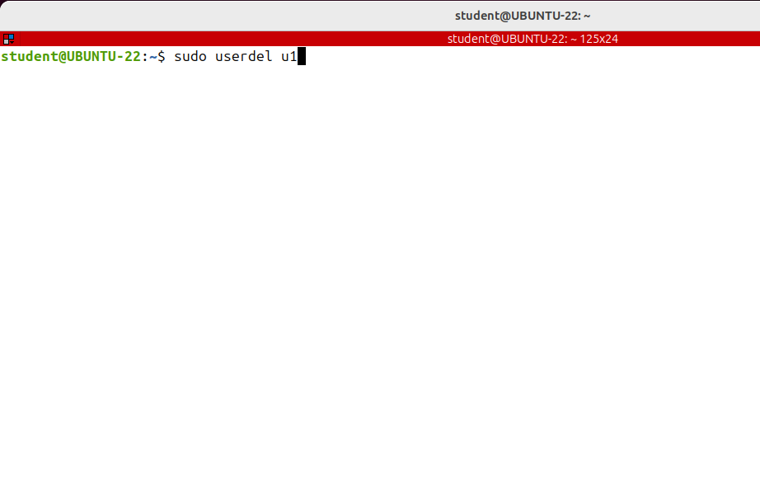

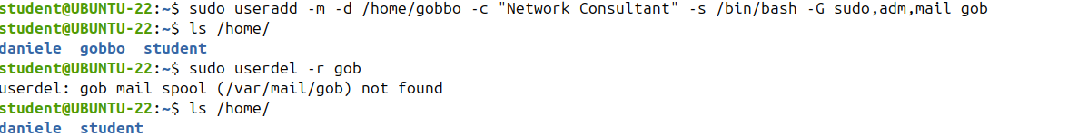
Changing and Removing User Accounts (usermod, userdel)
Now we want to know how to delete users.
In Linux you can delete a user account and all its associated files by using the userdel command.
It also deletes the group with the same name as the user, only if no other user is a member of that group.
The account was removed, but its home directory is still there.
To remove a user along with its home and mail spool directory use the -r option:
Note that the command didn't delete any other files that belong to the user and are located in other places; you have to search for and delete them manually.

Slide 12
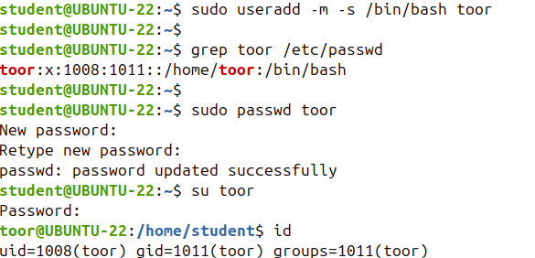

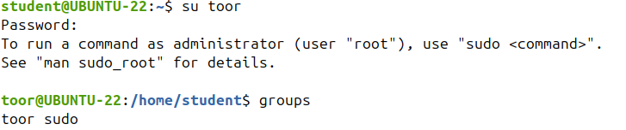
Creating admin users
A common administrative task is to give the user the possibility to run administrative commands as root.
By default only the user created at system installation time can run commands as root by prefixing them with sudo.
There are 2 predefined group names: sudo on debian and ubuntu based distributions and wheel on redhat and centos based distros.
If the user is part of this group then it can run
commands as root.

Slide 13
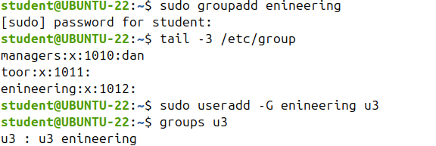
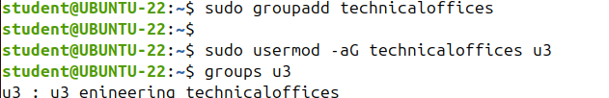
Group Management (groupadd, groupdel, groupmod)
To create a new group use the groupadd command.
In its simplest form you just specify the group name as argument. I’m creating a new group called “engineering”.

Slide 14
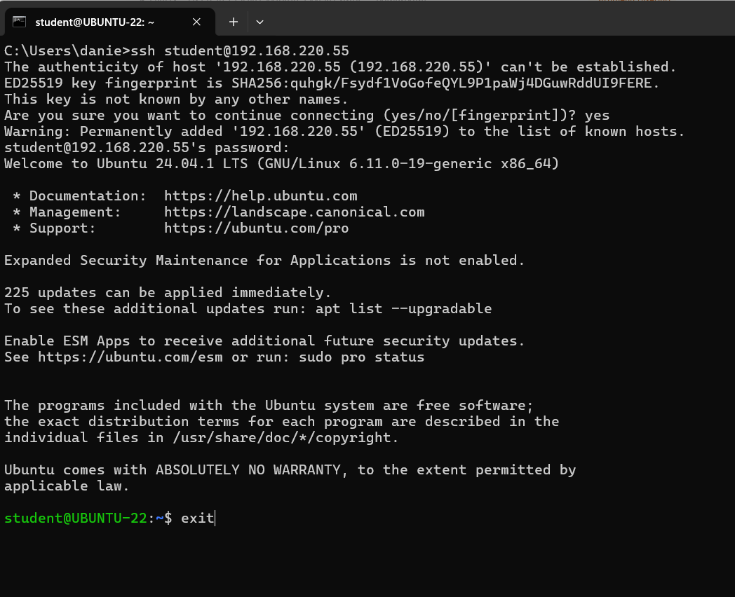
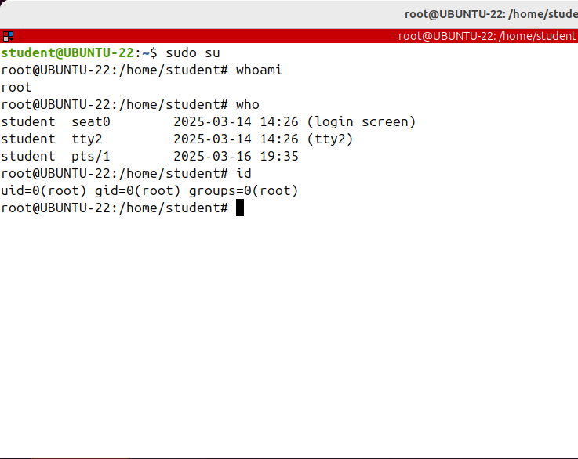
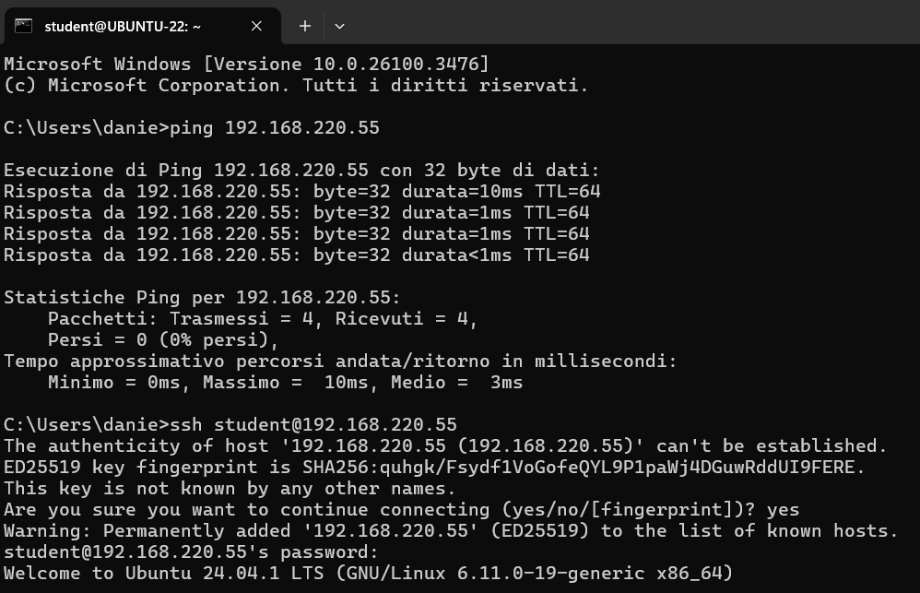
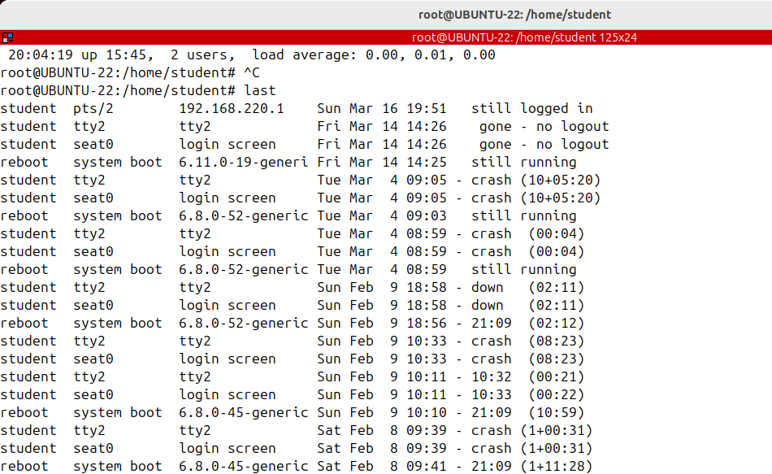
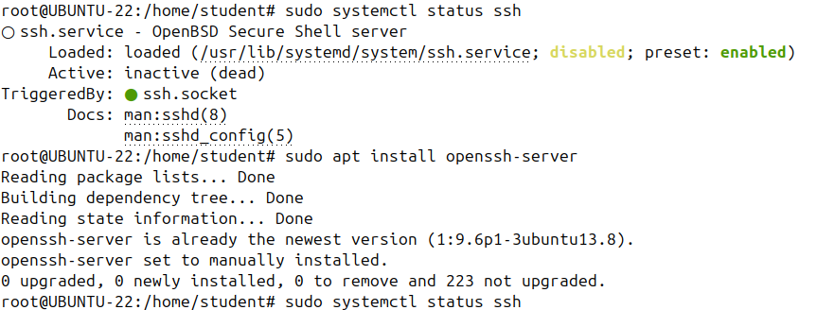
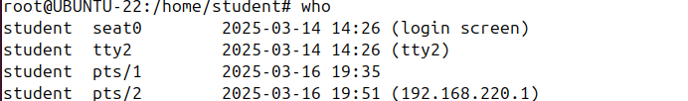
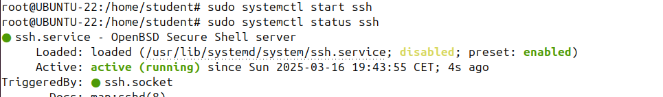
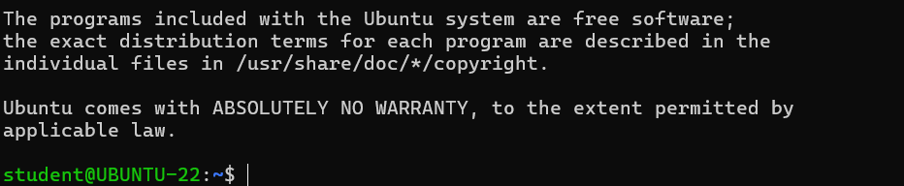
User Account Monitoring (whoami, who am i, who, id, w, uptime, last)
We'll be talking about user account monitoring, which means finding out who's logged into the system and what the users do. Because in Linux you can log in as a user and become another one by running the su command that there are two concepts:
the real user ID and the effective user ID.
The real user ID or are RUID is the id of the user who initially logs in and never changes.
On the other hand, EUID or effective user ID is the id of the user who executes a command in the shell.
The last command will cover is last.
It's very useful when you need to track users activity or investigate a possible security breach.
It shows a listing of the last logged in users.
Last reads the wtmp file, this one, and prints information about the logins and logouts of the users.
Records are printed in reverse order, starting from the most recent ones. And if you want to restrict the output to a specific user give that username as argument to last.

Slide 15
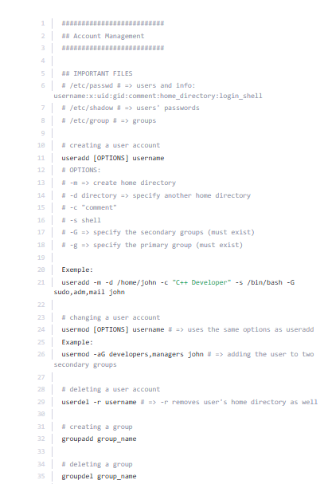
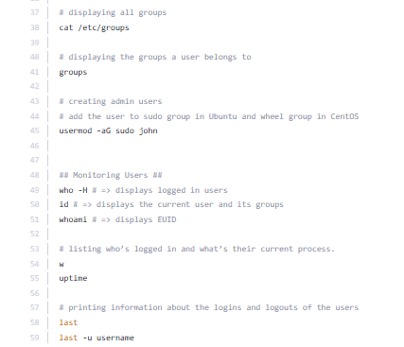
COMMANDS- Account Management

